Slide 2
The New York State Education Department is reviewing the Common Core Learning Standards to ensure the standards are right for New York’s students
An online, public survey allows the public to provide feedback on specific standards
Feedback will help inform any adjustments made to the standards
Survey is open now through Monday, November 30, 2015
The survey is available at http://www.nysed.gov/aimhighny
2

Slide 3
The New York State P-12 Common Core Learning Standards:
provide a consistent set of expectations for what students should learn and be able to do
are internationally-benchmarked and evidence-based
The New York State P-12 Common Core Learning Standards are not:
assessments
evaluations
curriculum
3

Slide 4
The survey provides an opportunity for every New Yorker
to go online, review each standard and comment on what
is liked, not liked, or offer a suggestion for a
change to a particular standard.
The survey is not a referendum on the standards. It is intended to:
increase awareness and understanding of New York’s current standards in ELA and math; and
gather actionable feedback from New Yorkers in order to adjust and improve the standards
4

Slide 5
The Common Core Learning Standards

Slide 6
The Move to Common Core
Whether they want to go to college or straight into the workplace, our students need to be able to think critically and solve complex problems.
In 2010, the Board of Regents adopted more rigorous, college and career-readiness standards to help ensure our schools are preparing all children for success upon graduation from high school.
Why Common Core?
They help all children—no matter who they are—learn the same skills.
They are clear expectations for what your child should know and be able to do in key areas: reading, writing, speaking and listening, language and mathematics.
If you know what these expectations are, then you can work with your child’s teacher and help your child prepare.
6

Slide 7
The Case for Common Core
Video by Council for Great City Schools
https://www.youtube.com/watch?v=e8ebMlCO1c8

Slide 8
Common Core in the Classroom
ELA/Literacy
Read both non-fiction and fiction
Learn about the world by reading
Read more challenging material closely
Discuss reading using evidence
Write non-fiction using evidence
Increase academic vocabulary
Mathematics
Focus: learn more about fewer key topics
Build skills within and across grades
Develop speed and accuracy
Really know it, really do it
Use it in the real world
Think fast AND solve problems
8

Slide 9
Learn more about the standards
Visit nysed.gov and engageNY.org
Talk to your child’s teacher
9

Slide 10
The Common Core Learning Standards Survey

Slide 11
Teachers, administrators, school board members, parents, the business community, and anyone with an interest in the future of our schools should participate in the survey.

Slide 12
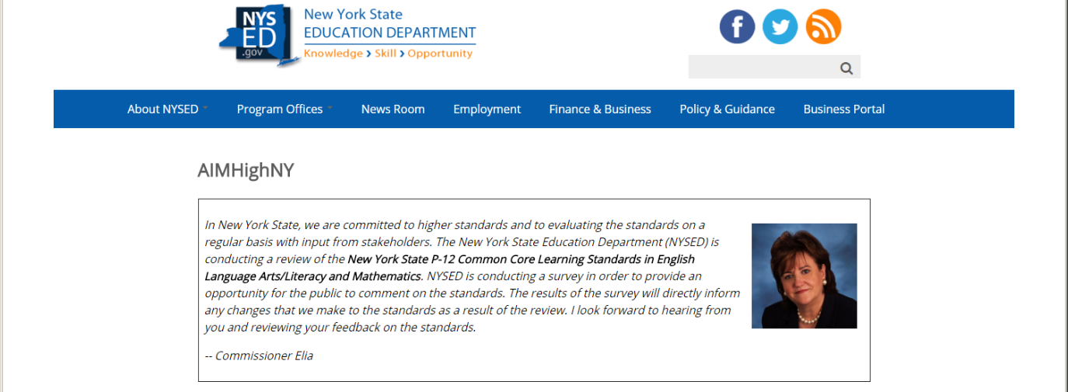
Navigating the Survey
The Welcome Page
Message from Commissioner Elia
Information about the survey format and purpose
Links to current ELA/Literacy and Math Common Core Learning Standards for prekindergarten through grade 12
12

Slide 13
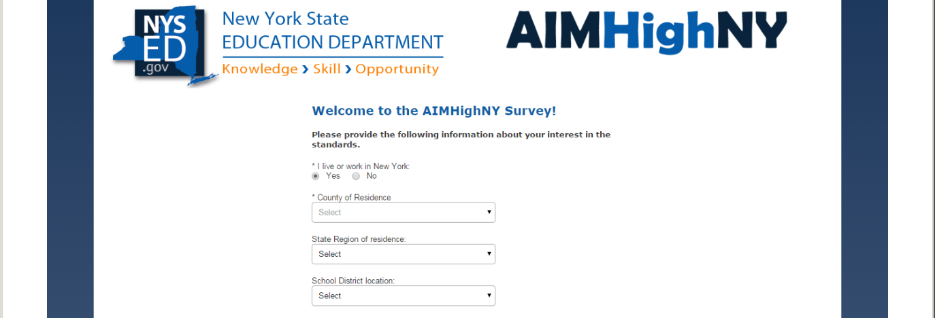
Navigating the Survey
Demographic Information
Before starting the survey, you must answer a few demographic questions and agree to the terms and conditions
Demographic information CANNOT be used to identify survey respondents
Information will help inform adjustments to the standards
13

Slide 14
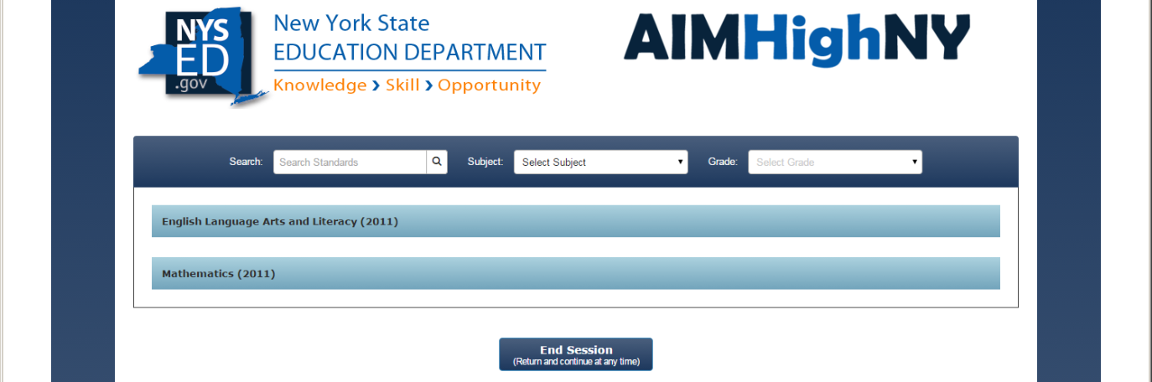
Navigating the Survey
The Survey
Standards are arranged by subject and grade level
To review a standard, click the plus sign beside the standard to view more detailed information
Browse standards within a subject and grade level or search for a particular concept by entering it in the search bar on the top left
Respondents do not have to comment on every standard—just on the standards about which they wish to provide feedback
14

Slide 15
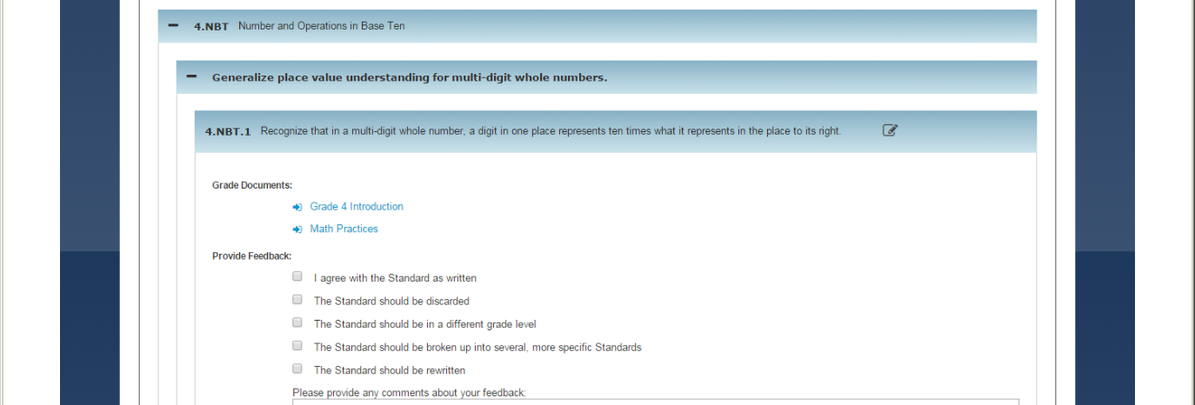
Survey Feedback
Once the survey closes…
Teams of New York educators, administrators, parents, and content experts in all grade levels will evaluate and review comments provided about specific standards
Any changes recommended by these teams will be presented to the New York Board of Regents for consideration
Changes to the standards would not be implemented until the 2016-17 school year or later
15

Slide 16
www.nysed.gov/AIMHighNY

